Slide 1
Team PRINT
Rohith Chintala, Brendan Cutick, Tyler Han, Elizabeth Myers, Eric Oh, Aidan Sandman-Long, Cynthia Sheng, Nathan Spicer-Davis, Kenji Tsukamoto, Nick Webb, Erik Zavorin
We pledge on our honor that we have not given or received any
unauthorized assistance on this assignment.

Slide 2
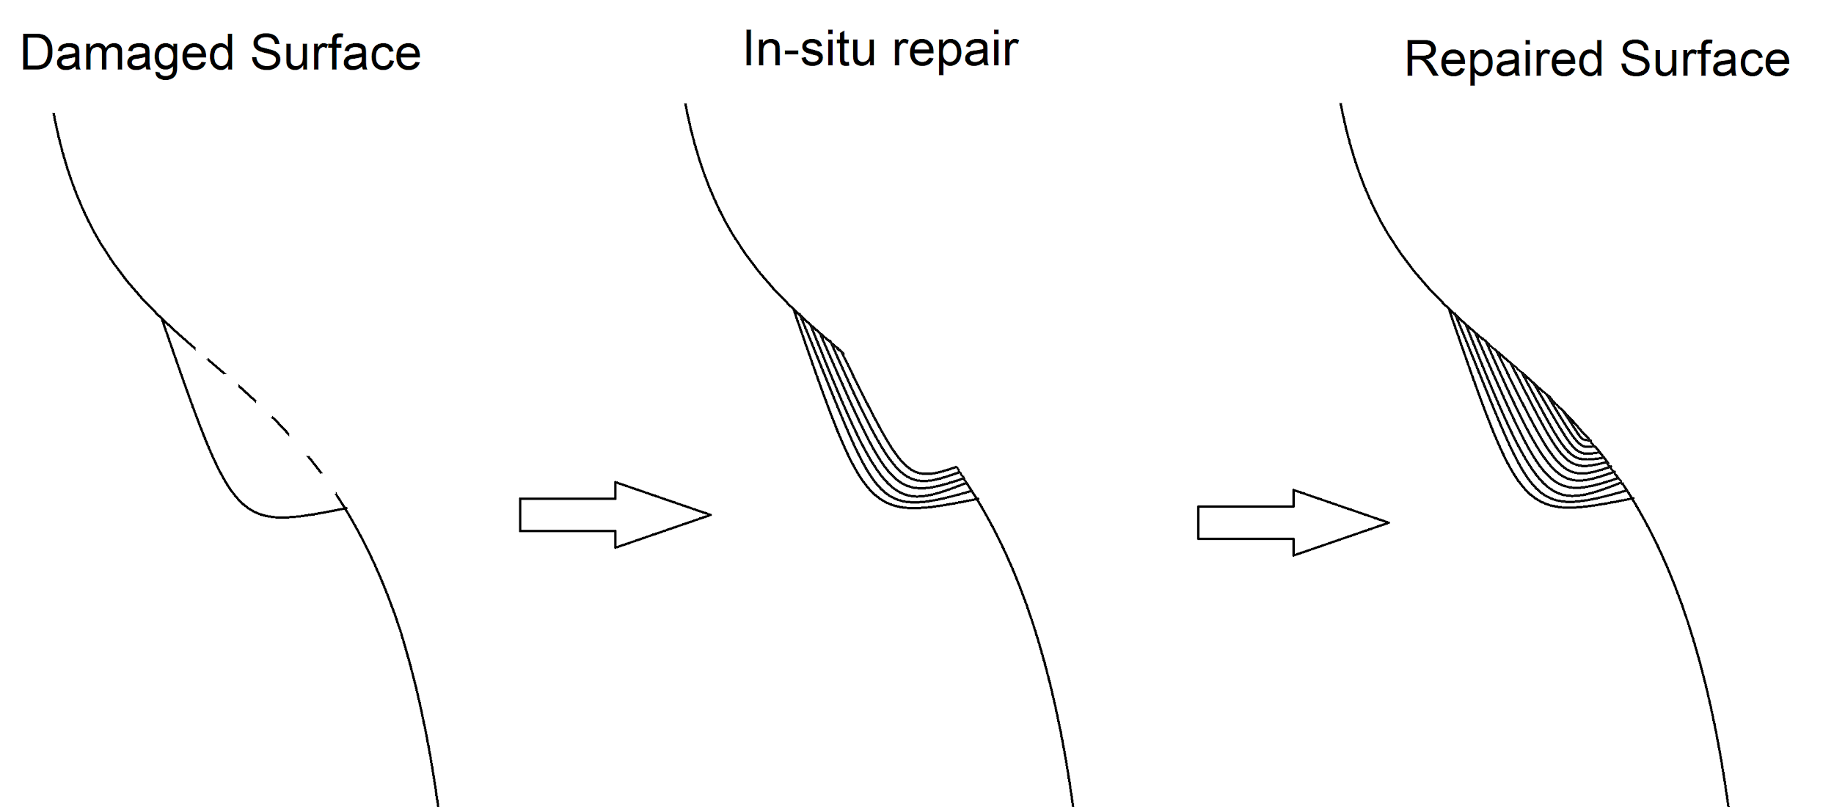
The Goal
Additive manufacturing solution to in-situ repairs
Additive Manufacturing - material is progressively added upon the previous structure
In-situ - in the natural environment; in place
Notes:
We’ll introduce our research first with the intentions as we aim to solve a problem with historically little research. We’d like to produce a device that is able to additively print repairs for some greater structure in the natural environment of its damage.

Slide 3
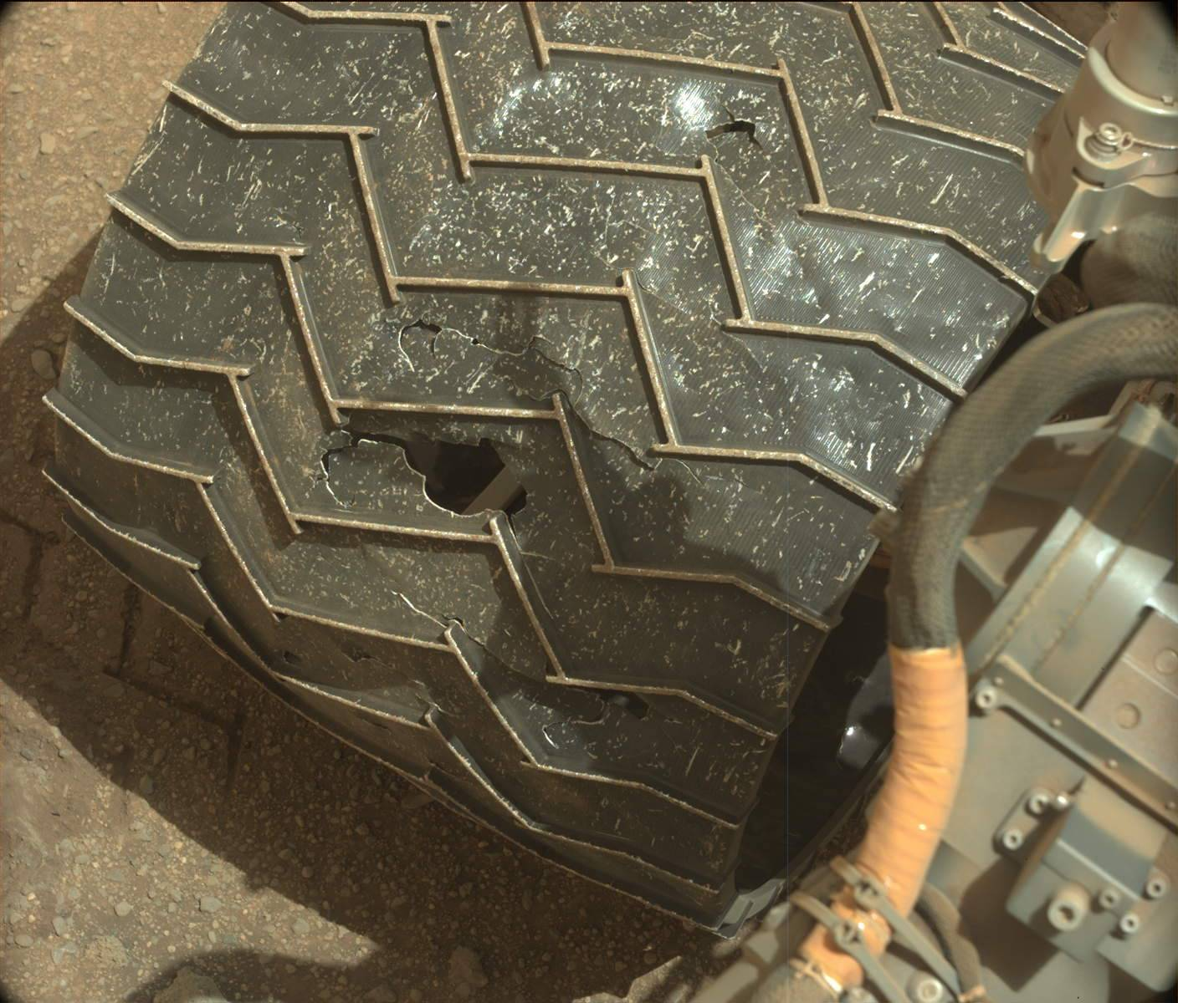
Why in-situ printing?
Applications to space systems, airplanes, and virtually anything that needs repairs
Rovers, on-orbit satellite servicing, partially damaged structures
Image from MastCam of Mars Curiosity Wheel Damage Source: NASA/JPL-Caltech/MSSS, Sol 962: Mast Camera (Mastcam). 2015
Notes:
The problem associated with this goal is a very general one: damage to any and all structures. For future work, the technology may aim to be generalizable to any environment friendly to additive procedures. Of course, we narrow the scope of this problem to damages such as those found on rover wheels and plane wings. Repairs to structures such as these require either autonomy or high-precision. More of this will be discussed later (in summary of literature review).

Slide 4
What existing manipulators can optimally guide the print head in-situ?

Slide 5
How can a traditional 3D printer extruder be modified for conformal printing?

Slide 6
How will the printer navigate through the environment?

Slide 7
Summary of Literature Review

Slide 8
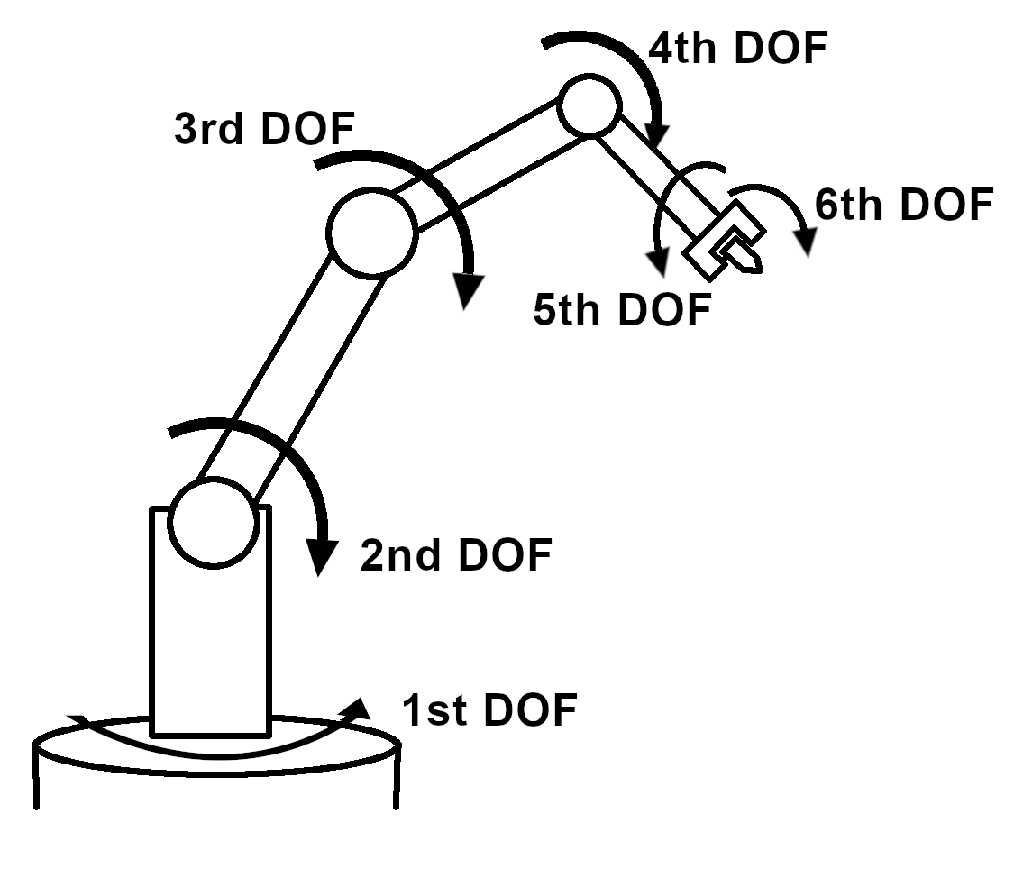
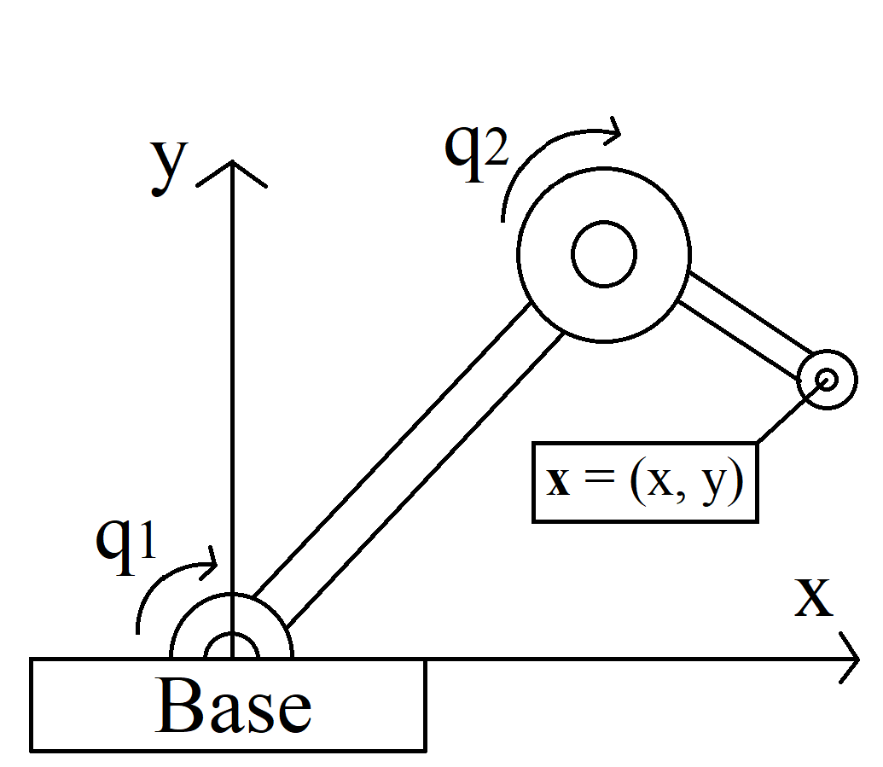
Structures
Required degrees of freedom (DOF)
Drivetrains
Motors and Gearboxes
Determining location of printhead
Kinematic Models
Inverse Kinematic Models

Slide 9
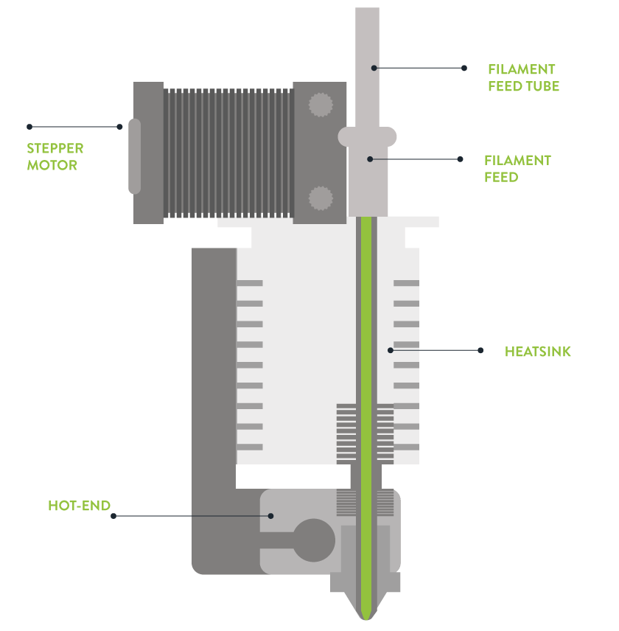
Extruder
Methods of 3D printing
FDM
Types of 3D printers
Bowden vs Direct Drive
Extruder filament
PLA
Design
“3D Printer Concepts and 3D Printer Parts.” Leapfrog 3D Printers, Leapfrog.

Slide 10
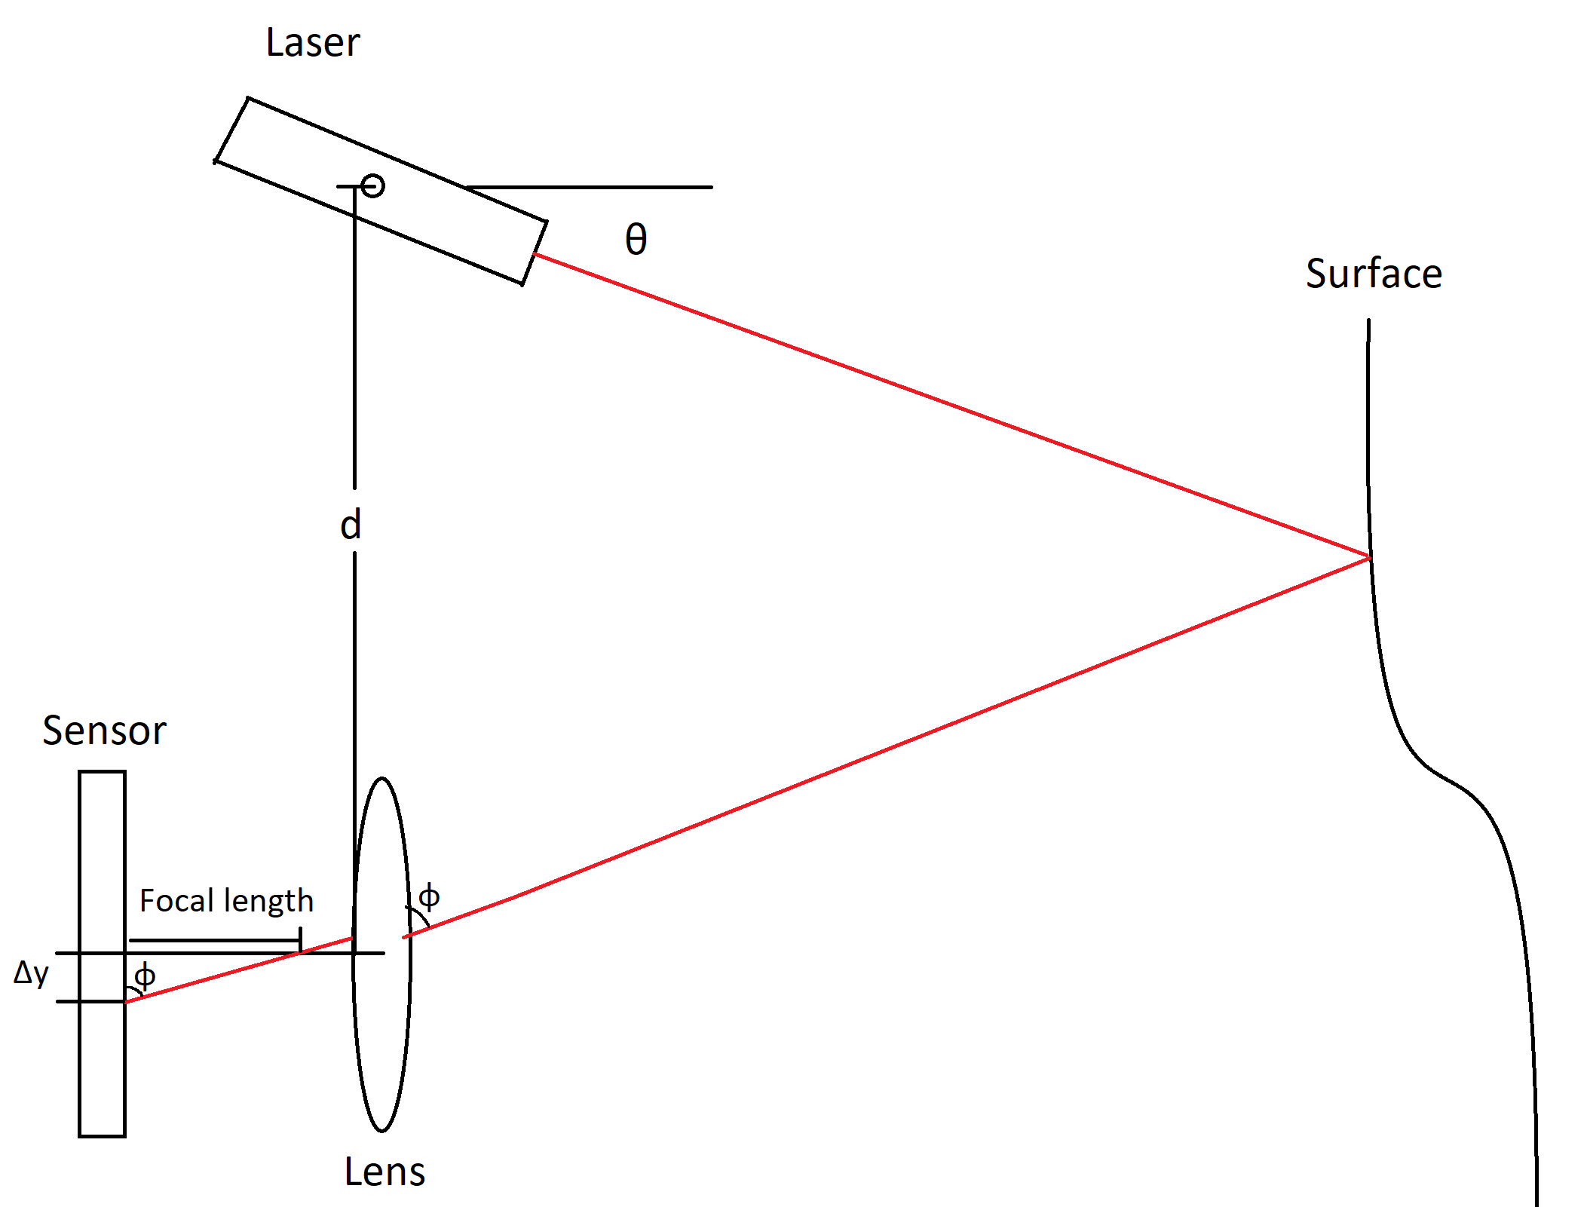
3D Scanning and Sensing
The print head must be aware of its environment
Avoiding collisions
Basis for developing a suitable toolpath
Ranging Scans
Time-of-flight based
Laser Triangulation
Uses geometry of known locations of laser emitter and camera
Tactile Sensing
Thin sheets of force-sensitive resistors
Notes:
In order to print into a priori-unknown environment. The printer must have information about its surface. This will help to avoid collisions and provide data on how to algorithmically create a suitable toolpath for manufacturing and navigation.
The primary types of scanners we would like to explore are ranging scanners, triangulation scanners, and tactile scanners. Ranging scanners are time-of-flight based and may be unsuitable for close-range scanning. However, they are comparatively simple with regards to deployment and noise. Triangulation scanners take advantage of the known geometry of the laser emitter and the camera. In contrast to ranging scanners, they are suitable for close-range scans but susceptible to noise. Tactile sensing is a scanning method that would be isolated to an environment that is insensitive to physical interaction (environments that are excluded are those with electronics or loose or moving parts). However, they provide a method for edge detection that is vital to computing edges and boundaries for generating a toolpath.

Slide 11
Overview of Methodology

Slide 12
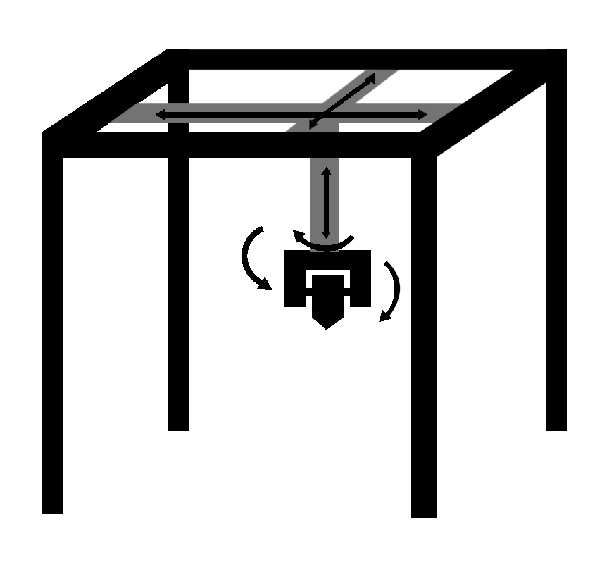
Robotic Manipulators
Robotic Arm:
Must attach extruder to robotic arm
More applicable to long-term goals
Expensive or non-exclusive use on campus
No need to add DOF
Traditional 3D Printer:
Extruder is already attached
Need to modify the printer to add DOF
Cheaper and easier to have exclusive use

Slide 13
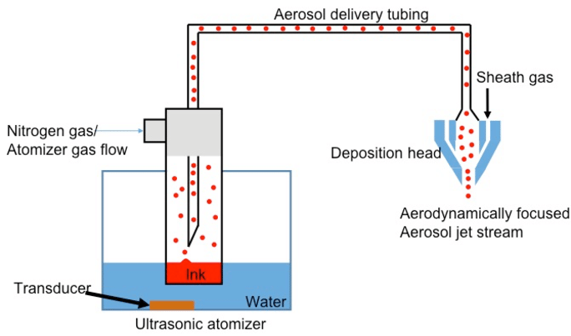
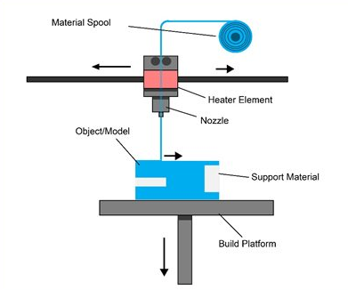
Methods of 3D Printing
Aerosol jet printing: small aerosolized droplets are propelled to the surface through a nozzle
Laminated object manufacturing: fuses sheets of plastic materials together and then shapes the intended object
Fused deposition modeling: material is heated and extruded in thin layers that adhere to each other while cooling
Aerosol Jet Printing
S. Agarwala, “Schematic of Aerosol jet printing process,” Research Gate, Jan-2017.
Fused Deposition Modeling
“FDM Fused Deposition Modeling,” 3D Printing Service Bureau .
Notes:
Aerosol jet: can be used on non-planar surfaces but very expensive
Laminated object manufacturing: not the most feasible for our research
Fused deposition modeling: most feasible option for our research

Slide 14
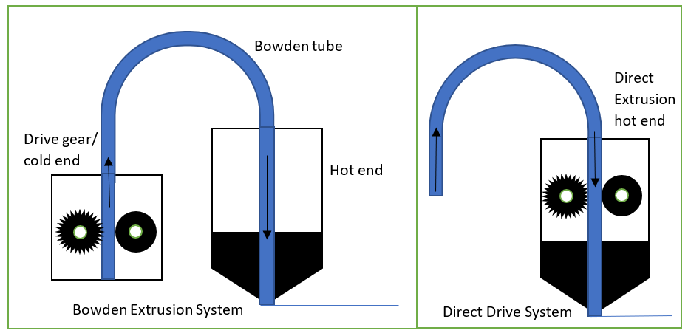
Extruder Design
Bowden vs Direct Drive
Bowden: Separate hot and cold ends, issues with filaments bending
Direct Drive: Larger size and weight
PLA Filament
Cheap and accessible
Challenges
PLA adhering to the surface
Navigating extruder through the print site

Slide 15
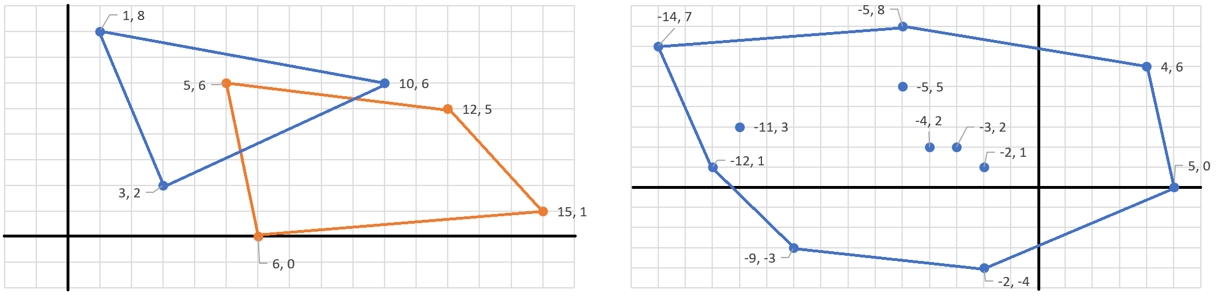
3D Scanning and Toolpathing
Scanning options:
Scanners provided by our mentor
Purchasing a scanner
Noise compensation using image smoothing
Toolpath generation
Rain-trapping algorithm
Iso-curves
Oriented Bounding Boxes (OBBs)
Two Convex Polygons
Minkowski Difference
Notes:
We found from our literature review that the primary methods of toolpath generation are using iso-curves. Iso-curves reproduce the scanned surface upwards while projecting the surface onto a hatching pattern for the print head. We would alternatively like to explore a ‘rain-trapping’ method where prints are made progressively at discrete elevations.
The use of Oriented Bounding Boxes (or OBBs) provides a method for collision detection, which are factors that must be taken into account when printing.

Slide 16
Timeline
Fall 2019
Design or buy an extruder head
Determine robotic arm/3D printer
Compare scanning options
Spring 2020
Determine detailed budget
Test 3D scanning options
Design extruders and extruder mount
Fall 2020
Begin integrating different systems
Create Toolpathing algorithms
Spring 2021
Minimum viable product integrated and tested
Results and findings written to thesis
Fall 2021
Research into features and suspended voids
Robustness testing
Spring 2022
Results prepared for presentation
New features and future work prepared

